Slide 1
Wages and Incentive Plan
Wages: Wages may be defined as payment for the use of labour who are selling their services.
Wages means compensation paid on an hourly basis.
Salary: Salaries is used to mean compensation of executives, supervisors, salesman and other employees paid on a basis other than an hourly rate.

Slide 2
Wages and Incentive Plan
Incentive : Incentive is an Inducement or a Reward which is given to a worker for his efficiency and hard work. It motivates and encourage a worker to produce more and better.
Fringe Benefit : Non money payment is called as fringe benefit

Slide 3
Incentive Plan
Straight Piece Rate System :
A worker is paid straight for the number of pieces which he produces per day.
Earning of a worker = No. of Pieces Produced x Rate Per Piece
Example : If a worker produces 16 flute per day and for each flute the wage rate is 5 taka, then he earns at the rate of 80 taka per day (8 hours per day)

Slide 4
Straight Piece Rate With Guaranteed Base Wage:
Assume,
An output standard of 16 pieces per day
A wage rate is 10 taka per hour
8 working hours in a day
Per piece wage is 5 taka
The guaranteed wage rate is = 8 x 10 = 80 taka
Now,
If a worker produces less than standard output he still gets 80 taka per day
If the worker produces 20 pieces per day, his earning will be 20 x 5 = 100 taka per day
Problem is,
A worker who produces ay 14 pieces per day, still gets 80 taka per day and his wage per piece is 80/14 = 5.71 taka
But the worker who produces 20 pieces per day, his wage per piece is = 100/20 = 5 taka

Slide 5
Differential Piece Rate System:
To overcome the problem of Straight piece rate with a guaranteed base wage system, Differential piece rate system introduced.
A worker who exceeds the output standard is paid a higher wage rate per piece and another who fails to do so gets his earning at a low piece rate.
Disadvantage:
The inferior or fresh workers who were unable to reach output standard, could earn very little and hardly survive.

Slide 6
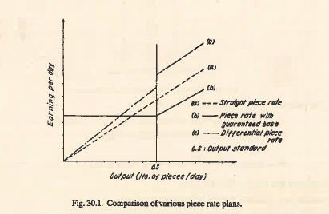

Slide 7
Halsey Plan :
An additional bonus is given to a worker who exceeds output standard(in a given time). He normally gets a percentage of the total bonus for the saved time. A very common percentage is 50-50. 50% bonus of the saved time is given to the worker and the rest 50% is enjoyed by management.
W = R x T + (S – T) x (P/100) x R
Here,
R = The hourly Wage rate = 10 taka
T = Actual time taken to complete the job = 4 hours
S = Standard Time or Allowed Time = 6 Hours
So,
W = 10 x 4 + (6-4) x (50/100) x 10
= 50 Taka

Slide 8
Rowan Plan
Like Halsey Plan provides a minimum guaranteed base wage and relies upon output standards based upon past production.
Unlike Halsey Plan, Gives bonus on (S-T / S) rather on (S-T)
In Rowan Plan,
W = R x T + (S – T / S) x R x T
= 10 x 4 + (6-4 / 6) x 10 x 4
= 53.3 Taka

Slide 9

Bedaux Plan:
B represents unit of work. 1B stands for 1 standard work minute and it includes working time as well as rest time. A worker earning “60B” per hour reaches 100% efficiency.
A bonus is paid to a worker who earns more than 60B in 1 hour. The bonus rate is 75%.
Here,
R = The hourly Wage rate = 10 taka
T = Actual time taken to complete the job = 4 hours
N_{T} = Number of B’s earned = 60 x 4 = 240
S = Standard Time or Allowed Time = 6 Hours
N_{S} = Standard Number of Point for that Job = 60 x 6 = 360
So,
W = 10 x 4 + ( 360 – 240 / 60 ) x (75/100) x 10
= 55 taka

Slide 10
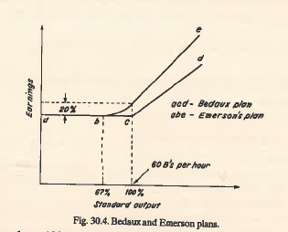
Emerson Efficiency Plan :
A worker having efficiency from 67-100%, earns an incentive from 0 to 20%
For efficiency above 100%, for every 1% increase in output, the worker gets 1% increase in incentive.

Slide 11
Group Incentive Plan:
Evaluate the collective performance of the group
Calculate total incentives and earnings, and
Divide the earnings in equal or any other proportion amongst the workers.
Advantages:
A team spirit builds up amongst the workers
Less skilled workers learned from the skilled ones
Less supervision required.
Disadvantages:
Slow worker gets the same money as speedy worker
Rise of conflict due to unequal division of money.

